Slide 1

Wireless Internet
Chapter 4 of Mobile Ad Hoc Wireless Networks + Various RFCS
Part of this material is adapted from standards, RFCs, the text book of the course, Raj Jain at Washington Univeristy at St. Louise, Wikipedia at http://en.wikipedia.org/,

Slide 2
Agenda
Wireless Internet issues and problems
Mobile IP
TCP in the wireless domain
Wireless Application Protocol (WAP)

Slide 3
WIRELESS INTERNET ISSUES AND PROBLEMS

Slide 4
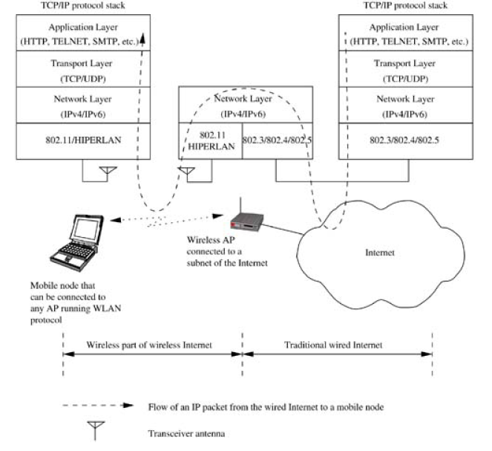
Architecture of Wireless Internet
Can we just stack the TCP/IP protocol on top of the wireless L1/L2 layers without any modification?

Slide 5
Issues on the Way of Wireless Internet
What is Wireless Internet (A.K.A Mobile Internet)?
  Extensions to services offered by Internet protocol stack to enable mobile users to access information seamlessly irrespective of their location
Major issues on the way to making wireless Internet a reality:
  Address mobility (A.K.A Mobile IP)
  Inefficiency of transport layer protocols
  Inefficiency of application layer protocols
  Security

Slide 6
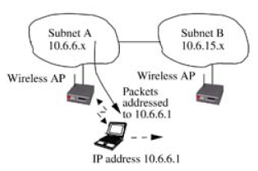
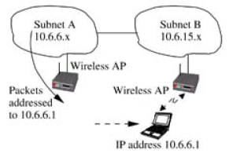

Address mobility (Mobile IP)
Theoretically each node has a unique IP address
IP address Structure
  Network identifier (Prefix): network to which the host is attached
  Host identifier (Suffix): address of the host on the network
32/128 bits
Network address
Host address
Routing based on prefix delivers the packet to the old network !!

Slide 7
Inefficiency of Transport Layer
Wireless link is unreliable and error prone
TCP is most commonly used transport protocols
TCP assumes packet loss is due to congestion
  Exponential (multiplicative) backoff ⇒ reduce window size by half
  Degraded performance ⇒ Low throughput on wireless links
Need to know the real cause of loss to react properly
Possible solutions:
  Indirect-TCP (ITCP), snoop TCP, and mobile TCP

Slide 8
Inefficiency of Application Layer
Wireless links are more expensive
Mobile device are less capable and energy constrained
HTTP, SMTP, IMAP, TELNET, FTP,…, etc.: All of these protocols are designed and optimized for wired network
Example: HTTP
  High overhead due to character encoding
  Redundant information carried in the HTTP requests
  Opening of a new TCP connection with every transaction Opens multiple TCP sessions
Example solution : WAP

Slide 9
MOBILE IP

Slide 10
Mobile IP
RFC3344 and RFC3775 (IPv6)
Mobile IP refers to the mobility aspects of the IP address
Possible quick solutions
  Change the IP address when the node moves
  Add special routing entries in the network
Problems with quick solutions
  Change the IP address
    TCP session disruption
    if the IP address itself changes, the TCP connection must be reestablished
  Add special routing entries
    Does not scale with high mobility and/or large number of hosts/mobile nodes

Slide 11
Ahmed Wants to talk to Mohammed
Can I speak to Mohammed
Ahmed
Mohammed’s
Secretary
Hello, Ahmed
HA
Can you connect me to Mohammed?
Mohammed
In his
Hotel Room
Mohammed, Ahmed is calling
Hotel
Operator
Hello, Ahmed
FA
We need
  Home Agent HA: Mohammed’s Secretary
  Foreign Agent FA: Hotel Operator

Slide 12
Basic MobileIP Architecture
MobileIP (no space between “Mobile” and “IP”) refers to a general purpose basic solution to the mobility problem over IPv4
  Remember that “Mobile IP” refers to mobility aspects of IP in general, not a particular solution
Basic Idea
  Home agent tunnels (encapsulates) traffic to the foreign agent
  Foreign agent delivers traffic to the mobile node

Slide 13
Terminology
Mobile Node (MN): The node to which mobility services is provided. May be a host or a router. E.g. PDA, 3G phone,…, etc
Home Network: The network to which the MN belongs to
Home Address (HoA): Long-term IP address of the MN on the home network
Home Agent (HA): Permanent node existing in the home network to act on behalf of the MN
Foreign Network: Any network other than the home network to which the MN is currently (or may be in the future) connected to
Foreign Agent (FA): Permanent node in the foreign network to which the MN is currently connected
Correspondent Node (CN): The node communicating with MN.
  May be fixed or mobile
  E.g. the Web server that is accessed by your PDA

Slide 14
What happens at a high level
Home Network
3.1.*
Correspondent node CN
(Ahmed)
8.1.1.1
Mobile node
(Mohammed)
3.1.10.10
Home agent
(Secretary)
3.1.1.1
Internet
Mobile Node
(Mohammed)
3.1.10.10
Foreign Agent
(Hotel Operator)
4.1.1.1
Foreign Network
4.1.*

Slide 15
Addressing and basic forwarding
FA-based COA: It is the address of the FA
  The HA intercepts the packets from the CN.
  The HA tunnels the packet to the FA-COA
    Care-of-Address (COA): Address to which the packets are sent by the home agent. Destination of the IP tunnel between home agent and the mobile.
  The FA decapsulates the packet and forwards it to the MN
Colocate COA: The MN acquires two addresses
  The second address belongs to the foreign network
  The HA tunnels the packet to the MN directly

Slide 16
Forwarding for FA-based COA
Home Network
(3.1.*)
Correspondent node
8.1.1.1
Mobile node
3.1.10.10
Home agent
3.1.1.1
8.1.1.1
3.1.10.10
payload
Internet
3.1.1.1
4.1.1.1
Outer header
Original packet
8.1.1.1
3.1.10.10
payload
Mobile Node
3.1.10.10
Foreign Agent
4.1.1.1
Foreign Network
4.1.*

Slide 17
Forwarding for Colocated COA
Home Network
(3.1.*)
Correspondent node
8.1.1.1
Mobile node
3.1.10.10
Home agent
3.1.1.1
8.1.1.1
3.1.10.10
payload
3.1.1.1
4.1.10.10
Internet
Outer header
Original packet
8.1.1.1
3.1.10.10
payload
Mobile Node
4.1.10.10
(3.1.10.10)
Foreign Agent
4.1.1.1
Foreign Network
4.1.*

Slide 18
MobileIP Operation Forward
Agent Discovery: To find agents
  Home agents and foreign agents advertise themselves periodically on network layer and optionally on data link
  They also respond to solicitation from mobile node
  Mobile can send solicitation to Mobile agent multicast group 224.0.0.11
  Mobile selects an agent and gets/uses care-of-address
Registration with HA
  Mobile node registers its care-of-address (COA) with home agent.
    registers directly for colocated COA
    registers through foreign agent for FA-based COA
  Home agent sends a reply to the CoA after proper authentication
  Each "Mobility binding" has a negotiated lifetime limit
  To continue, reregister within lifetime

Slide 19
MobileIP Operation
Return to Home:
  Mobile node deregisters with home agent sets COA to its permanent IP address
  Lifetime = 0 ⇒ Deregistration
  Deregistration with foreign agents is not required.
    Expires automatically

Slide 20
Mobile IP Operation
Reverse Tunneling (RFC 3024)
MN tunnels packet destined to the CN to HA
  Internal header: SA = home address, DA=CN address
  Tunnel header SA = COA, DA = HA
HA decapsulates the packet
HA sends the packet to the CN
This is called triangular routing: MN → HA → CN
Suboptimal routing but it works !!

Slide 21
Is MobileIP Good
Advantages
  It works: Works with the current Internet
  Only FA and HA need to change
Disadvantages
  Tunneling overhead (at least 20 bytes IP header)
  Suboptimal routing
  MN depends on FA to provide COA unless it can acquire address itself

Slide 22
TCP IN WIRELESS DOMAIN

Slide 23
TCP in the Wired Domain
TCP is specified in RFC 793
More info/extensions in
  RFC 1106: Selective repeat instead of go back n
  RFC1122: Host requirements
  RFC 1323:TCP Extensions for High Performance
Designed to work over connectionless, unreliable networks
Services offered by TCP to the upper layer
  Stream oriented
  Connection oriented
  Reliable

Slide 24
TCP
Each application is on an endpoint is assigned a port
  Port: Point to which the application layer attaches to TCP
  TCP uses port to multiplex to the correct application
  A port is a 16 bits integer
  Local to the endpoint
  Ports number up to 1024 are well known ports (www.iana.org)
  An application can attach itself to a multiple ports
    TCP views different ports as different application
    Implementation may have a single process handling multiple applications
Point to Point full duplex connection
  A TCP session is identified by the quadruple
    (Source IP Address, Source Port, Destination Address, Destination Port)

Slide 25
TCP
Application views TCP connection as byte stream
TCP divides the byte stream into segments
  Segment can be up to 64k
  Each Segment has a header
  A segment usually occupies a single IP datagram
  TCP Segment Size = Ethernet Payload Size – IP HeaderSize
  TCP Payload Size = Ethernet PayloadSize – IP HeaderSize – TCP SegmentHeaderSize
IP header
TCP segment header
=
+
+
Byte stream
Segment
Segment
Segment

Slide 26
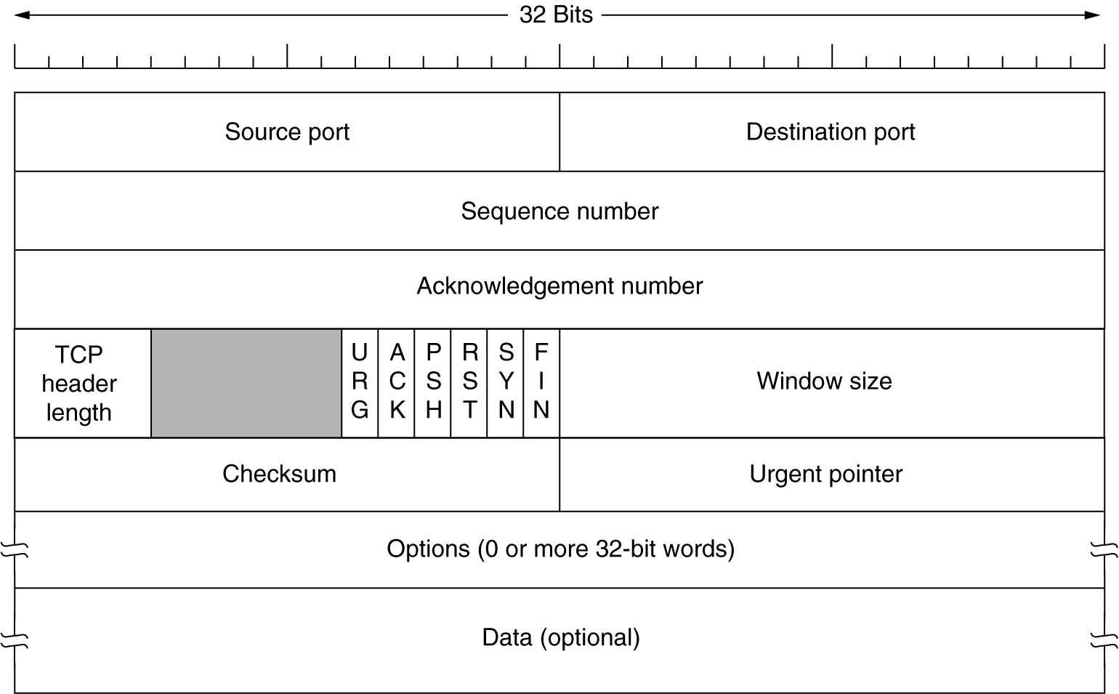
TCP Header

Slide 27
TCP Header
Source port and Destination Port: applications on endpoints
Sequence Number: The sequence number of the first data octet in this segment
  If SYN flag is set the sequence number is the initial sequence number (ISN) and the first data octet is ISN+1.
Acknowledgment Number: If the ACK control bit is set this field contains the value of the next sequence number the sender of the segment is expecting to receive.
Header length (Data offset in the RFC): The number of 32 bit words in the TCP Header
  This value points to where the data starts from the beginning of the segment.
Window: The number of data octets beginning with the one indicated in the acknowledgment field which the receiver of this segment is willing to accept.
  Window size zero indicates that receiver has received bytes up to ACK-1 but cannot receive any more data at this point in time

Slide 28
TCP Header
Control Bits: 6 bits (from left to right):
  URG: Urgent Pointer field significant
  ACK: Acknowledgment field significant
  PSH: Push Function
  RST: Reset the connection
  SYN: Synchronize sequence numbers
  FIN: No more data from sender

Slide 29
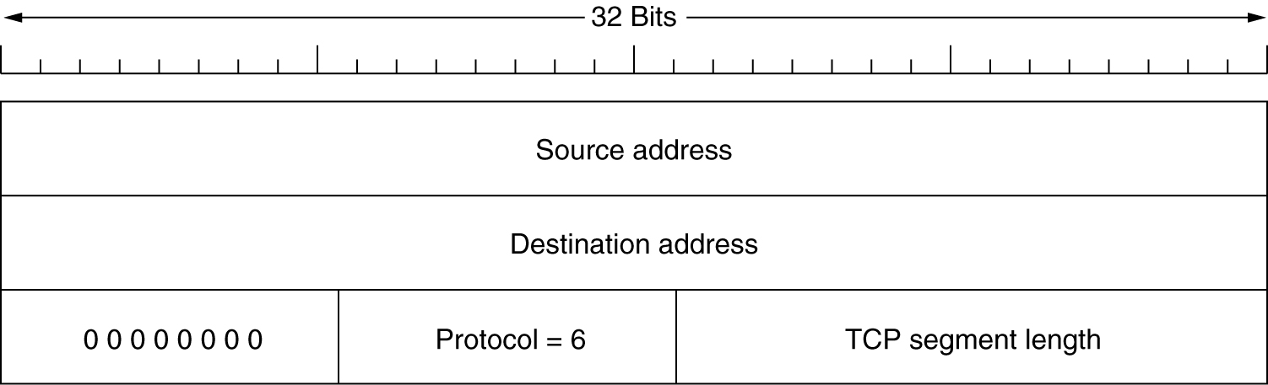
TCP Pseudo Header
Checksum 1’s complement of the sum of all 16 bits in the segment
  Covers the entire segment, and
  Includes the pseudo header (most important parts of IP header)

Slide 30
How does TCP determine the Size of the Segment
On the transmitter side, TCP prepares the segment and transfers it to IP layer
The network layer is responsible for delivering the segment to the other side
  Even if there was fragmentation, the IP layer is responsible for reassembly and delivering the IP payload (which is the TCP segment) to the TCP layer
  IP layer does not guarantee delivery
Suppose there was a problem
  Corruption
  Missing data
  Extra data added to the segment
TCP on the receiver side applies checksum to the entire segment received from the IP layer
  Thus all problems are detected
    Drop the entire segment if checksum fails
Loss of a segment is handled via timeout and retransmit

Slide 31
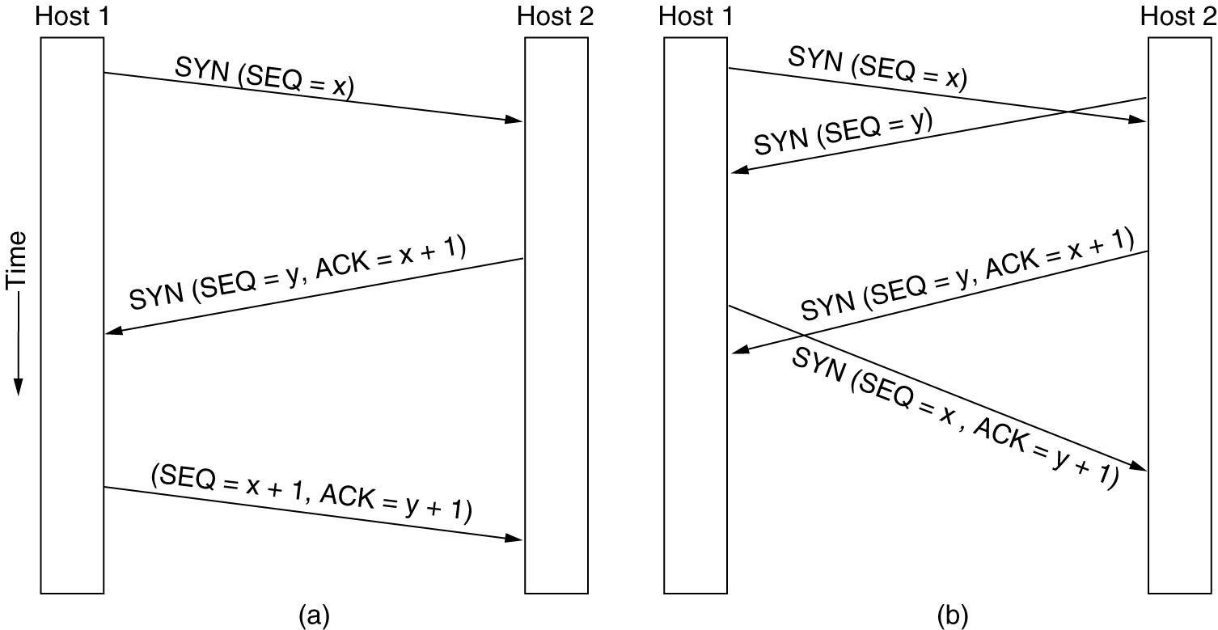
TCP Connection Establishment
Connection Establishment Simultaneous Connection Establishment

Slide 32
TCP Connection Release
Endpoint no longer having data sends segment with FIN
When FIN is ACKed then flow terminates in the direction from the endpoint that sent the FIN
Flow can continue indefinitely in the opposite direction
Timeout can be used to release connection when FIN is not ACKed
  Endpoint sending FIN waits for two packet lifetime before releasing connection
  Other endpoint notices that there are no packets and should release the connection

Slide 33
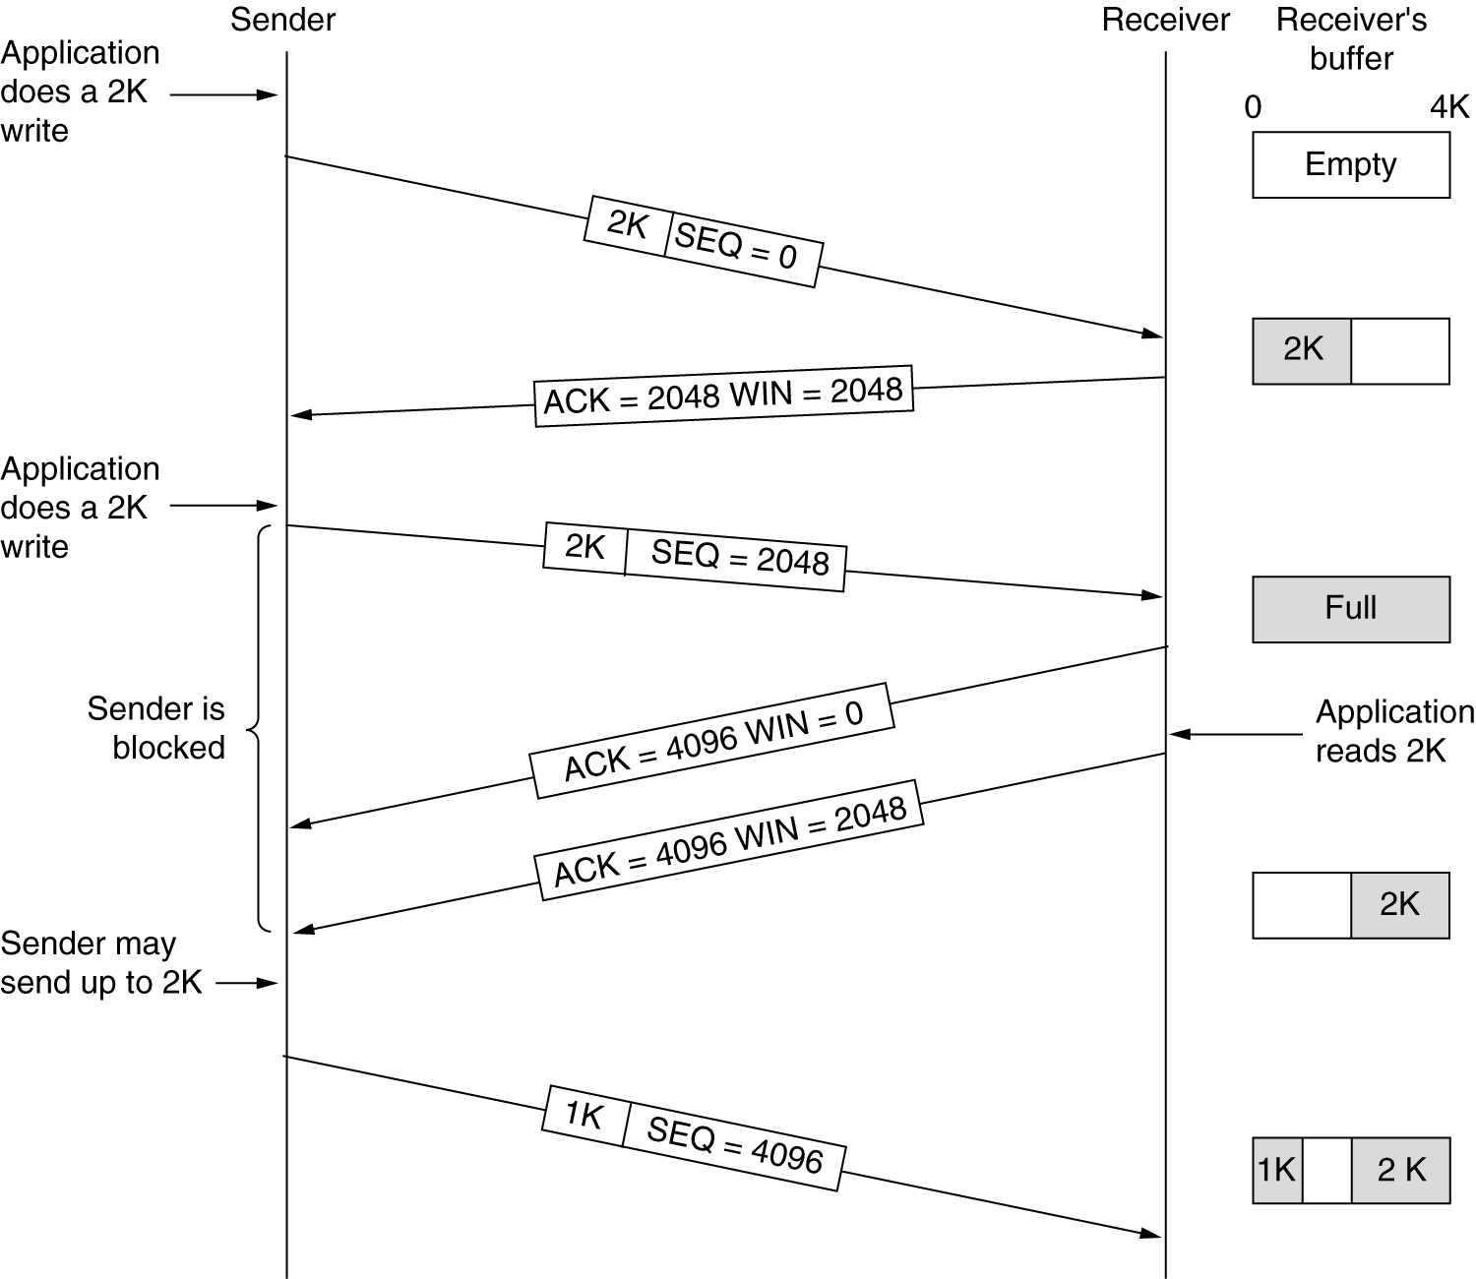
TCP Data Transmission
Windowed protocol

Slide 34
Basic TCP Congestion Management
Sender maintains two windows
  Receiver window: What the receiver agreed to
  Congestion window: What the sender thinks is the right window size for the current network condition
  Transmission window = min {Receiver, Congestion}
Initial transmission window = maximum segment size (MSS)
Double transmission window with every successfully ACKed window
  If the sender sends n segments and all n segments are ACKed before timeout, transmission window becomes 2n
Congestion Window:
  Window grows exponentially until threshold is reached and then congestion window is incremented by 1
  Until sender window is reached OR Timeout occurs

Slide 35
Basic TCP Congestion Management
On Timeout
  Assume because of network congestion
  Threshold is reduced to half before and restart the process
  Transmission size is back to 1 MSS
End result
  Oscillation between two window sizes

Slide 36
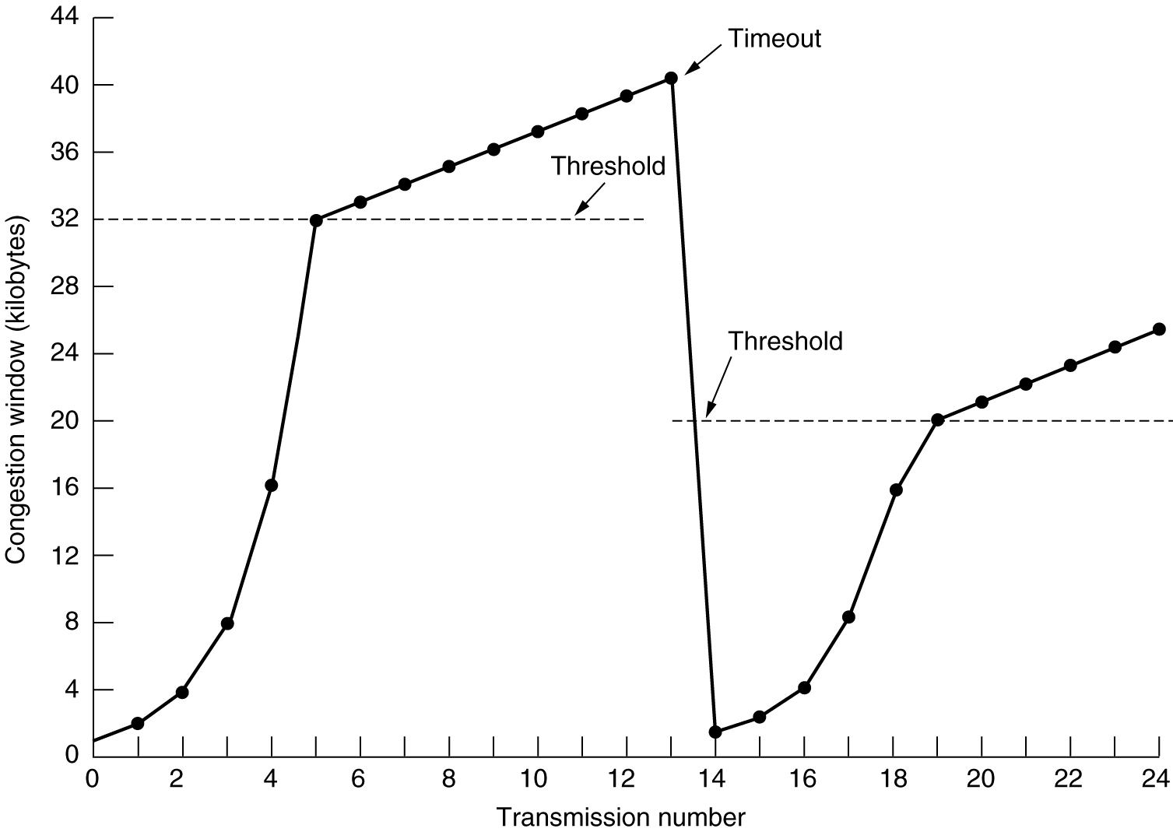
Basic TCP Congestion Management
Window size at time out
Linear
window
Growth
(slow start)
Threshold = ½ window size
at timeout
Exponential
window
grown
Congestion window
after timeout
= 1 MSS

Slide 37
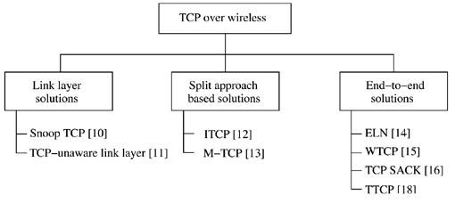
Modification to TCP for wireless

Slide 38
1. Snoop TCP
BS is the Player
BS buffers TCP packets from CN
BS maintains its own timeout
BS retransmits to MN on timeout or duplicate Ack from MN
BS does NOT send ACK to CN on behalf of MN
If MN transmits data to CN and BS detects a gap in the sequence, BS sends NACK to MN to indicate loss
BS timeout is much smaller than TCP timeout
Advantage
  Maintain end-to-end property of TCP
  BS needs to buffer only one window size
    The BS does not send ACK. Hence the CN will send a window and block until it receives ACK
Disadvantages
  Does not work with encryption
  BS needs to be TCP aware
Notes:
The basic concept is to buffer packets close to the mobile node and retransmit them locally if a packet is lost.

Slide 39

2. Indirect TCP (ITCP)
Split the TCP connection into two connection
Normal TCP over the wired link
Customize TCP implementation over the wireless link
AP needs to buffer packets from/to MN
  Buffer may grow large (e.g. handoff, temporary obstruction behind buildings, large noise burst,…, etc.
Advantage:
  No need to change TCP for CN
  Avoid slow start by the CN
Disadvantage
  Breaks end-to-end semantics. Suppose the AP sends an ACK to the CN but was never able to deliver the segment to the MN (e.g because the MN has crashed)
  Buffer grows to infinity (in theory) because AP needs to buffer all segments for which it sent ACK to the CN

Slide 40
3. M-TCP
Special handling of lengthy and/or frequent disconnections
M-TCP splits as I-TCP does
  unmodified TCP fixed network to supervisory host (SH)
  optimized TCP SH to MH
Supervisory host
  no caching, no retransmission
  monitors all packets, if disconnection detected
    set sender window size to 0
    sender automatically goes into persistent mode
  old or new SH reopen the window
Advantages
  maintains semantics, supports disconnection, no buffer forwarding
Disadvantages
  loss on wireless link propagated into fixed network
  adapted TCP on wireless link

Slide 41
4. TCP SACK
Selective Acknowledgment
Normal TCP uses cumulative ACK and go-back-N
Modify TCP to perform selective ACK
  Sender retransmits packets based on selective ACK from receiver
Improves performance over wireless because only lost segments are retransmitted
Requires TCP modification

Slide 42
5. Explicit Loss Notification
BS detects a non-congestion of loss. e.g.
  Handoff
  Error in L2 frame due to noise
Sends ELN to sender
  sender does not reduce window size on timeout
  Avoids slow start
MAC layer at the MN needs to be changed
TCP at the CN needs to be changed

Slide 43
6. WTCP
Separate congestion and reliability
  Use two sequence numbers, one for each
Now we can know whether the loss is because of congestion or packet drop on the link layer
Requires changes in TCP at the CN

Slide 44
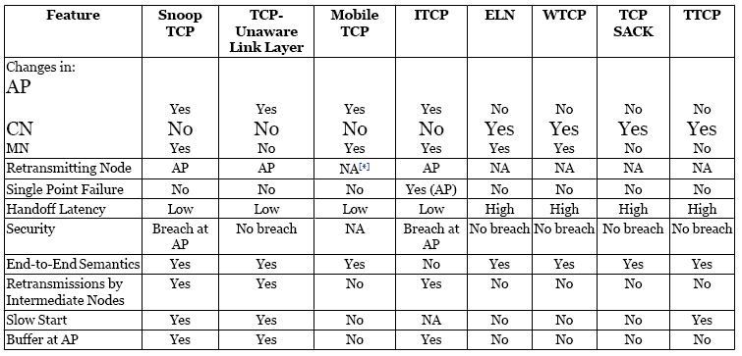
Comparison

Slide 45
WIRELESS APPLICATION PROTOCOLS

Slide 46
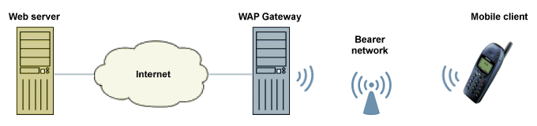
Wireless Application Protocol WAP
WAP has today become the de facto standard for providing data and voice services to wireless handheld devices.
WAP aims at integrating a simple lightweight browser also known as a micro-browser into handheld devices, thus requiring minimal amounts of resources such as memory and CPU at these devices.
The WAP gateway carries out the necessary protocol translation and content encoding

Slide 47
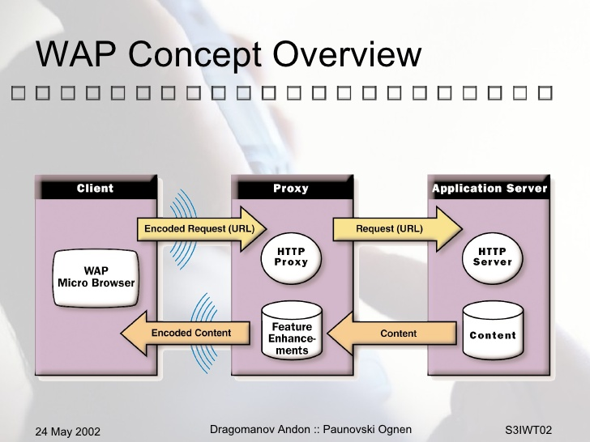
WAP Overview

Slide 48
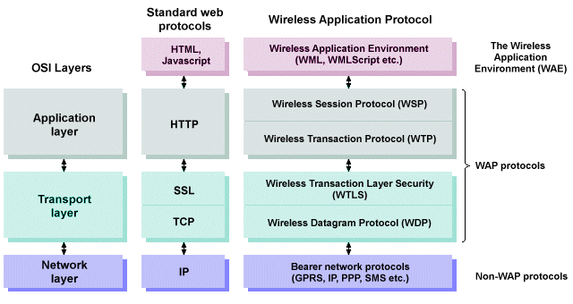
WAP Protocol Stack

Slide 49
WAP 1.x Protocols
The WAP 1.x protocols enable communication to take place between the WAP gateway and the micro-browser. They are described below (note that the network layer bearer protocols are not a part of the WAP specification).
Wireless Session Protocol (WSP) - with WTP, a complete replacement for HTTP, allowing the efficient exchange of data between mobile web applications.
Wireless Transaction Protocol (WTP) - provides transaction support (reliable request/response) to the datagram service provided by WDP.
Wireless Transport Layer Security (WTLS) - an optional security layer based on the Secure Sockets Layer(SSL) protocol that provides a secure transport layer connection using encryption.
Wireless Datagram Protocol (WDP) - a transport layer datagram service like UDP that sends and receives messages via any available bearer network, providing unreliable transport of data. The precise implementation of WDP is dependent on the network layer protocol used by the bearer network, although on IP-based networks it is effectively the same as UDP.

Slide 50
WAP 2.0
The original WAP protocol stack with standard Internet protocols. It does not therefore require a WAP gateway, but a proxy server is often used to optimise communication.
The Wireless Markup Language (WML) has been replaced by XHTML Mobile Profile (XHTML MP), a cut-down version of XHTML:
  multimedia content can be sent to a WAP device using the Multimedia Message Service (MMS)
  Push – a mechanism that allows network servers to initiate the delivery of content to a WAP client device (as opposed to the normal pull model in which the server must wait for a request from the client device)

Slide 51


